Slide 1
Solving word problems

Slide 2
Process
Read the problem.
Identify the variables and the question to be answered.
Write equations that use the variables and describe the situation.
Solve the equations.
Check your solution for correctness and reasonableness.

Slide 3
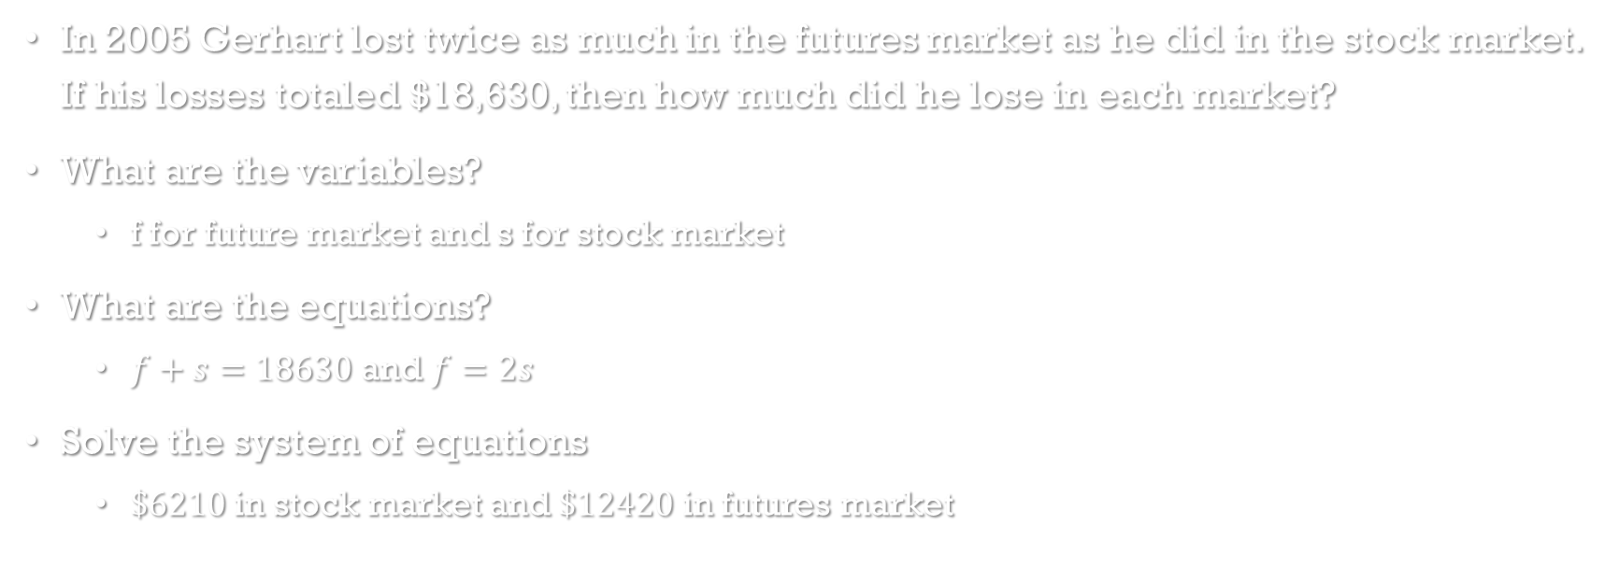
Stock market Losses
In 2005 Gerhart lost twice as much in the futures market as he did in the stock market. If his losses totaled $18,630, then how much did he lose in each market?
What are the variables?
f for future market and s for stock market
What are the equations?
$f+s=18630$ and $f=2s$
Solve the system of equations
$\$6210$ in stock market and $\$12420$ in futures market

